Slide 1


Distracted Driver Summit
September 29, 2017
Captain Jerry L. Davis
Virginia State Police
Bureau of Criminal Investigation – Wytheville Field Office

Slide 2
Autonomous Vehicles and the Impact on Law Enforcement
What is it?
Autonomous vs Connected technology
Regulation
Liability / Insurance
Cyber concerns
Questions

Slide 3




Slide 4


Slide 5




TRANSPORTATION SYSTEM
250 Million Vehicles
4 Trillion Passenger Miles
1.3 Trillion Motor Carrier Ton Miles
4 Million Miles of Roadway
Supports generation of 15.685 billion in GDP

Slide 6
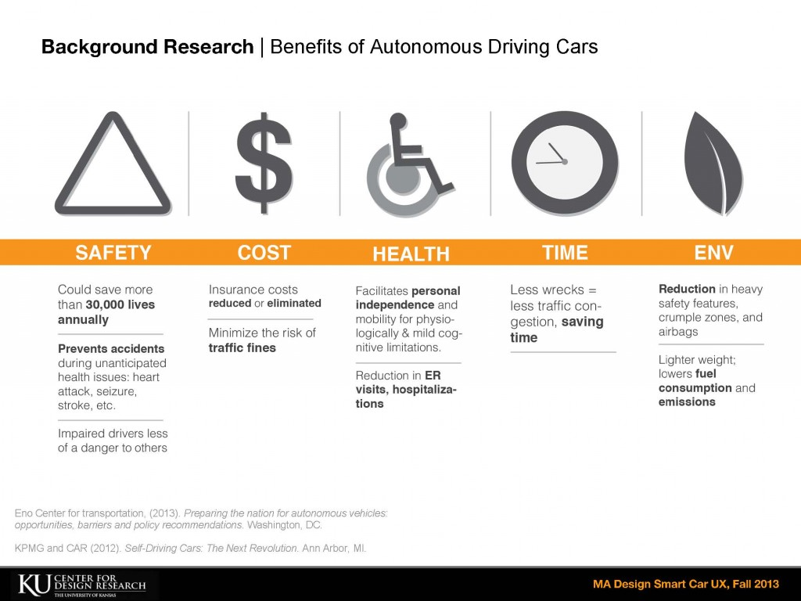

Slide 7
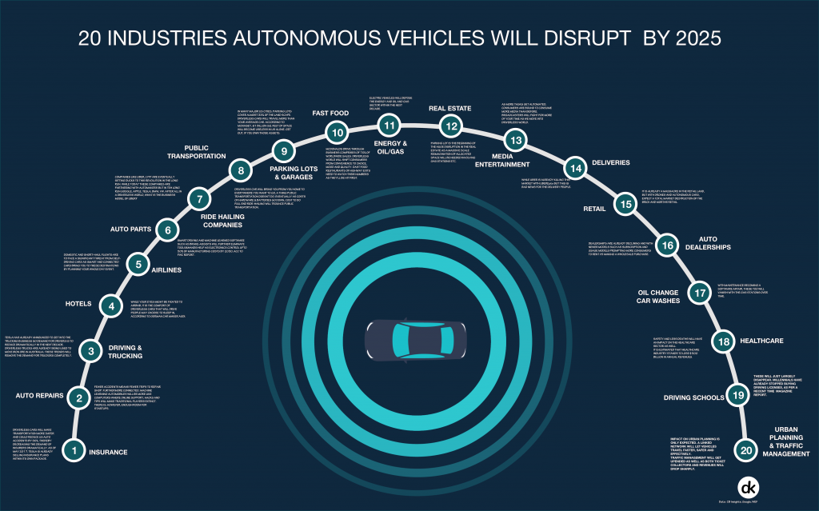
Sources: CB Insights, McKinsey, Google Search, BCG, Economist, WEF, Statista.
Notes:
https://tarrysingh.com/wp-content/uploads/2017/05/Autonomous-Vehicles-2-1024x639.png

Slide 8
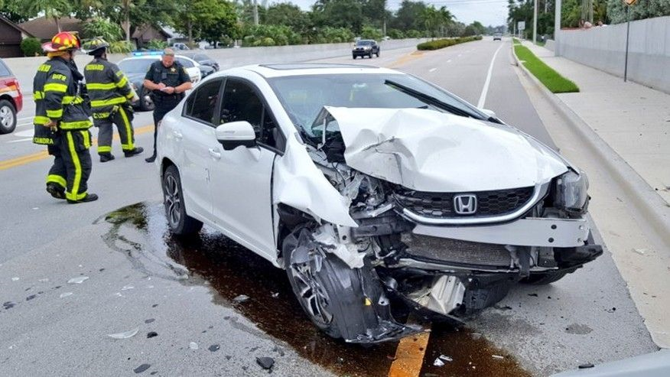
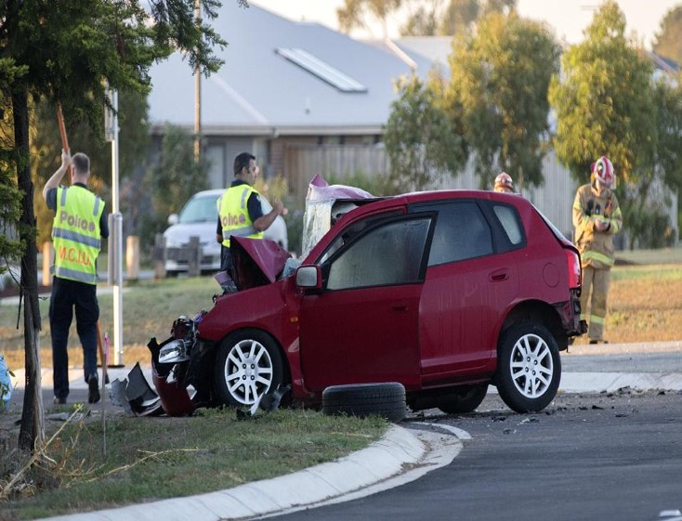

Slide 9
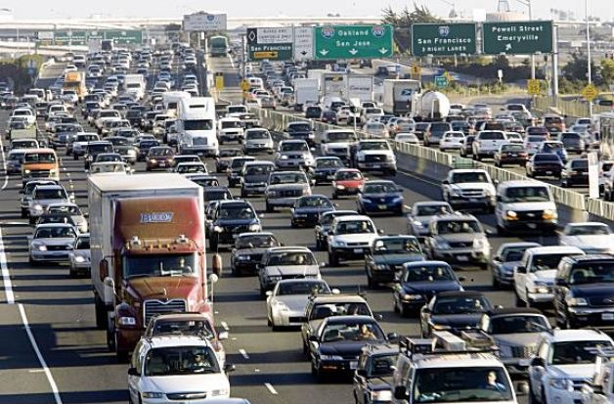

Slide 10
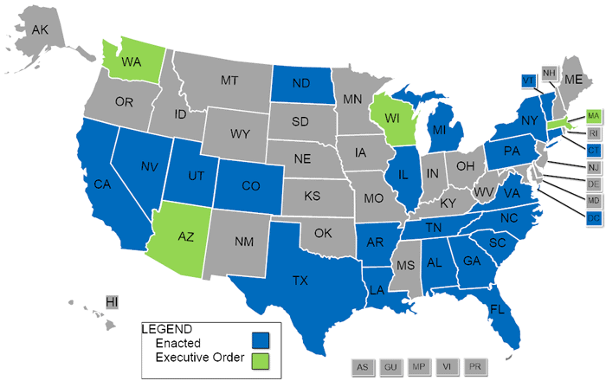
Enacted Autonomous Vehicle Measures
Source : National Conference of State Legislators

Slide 11
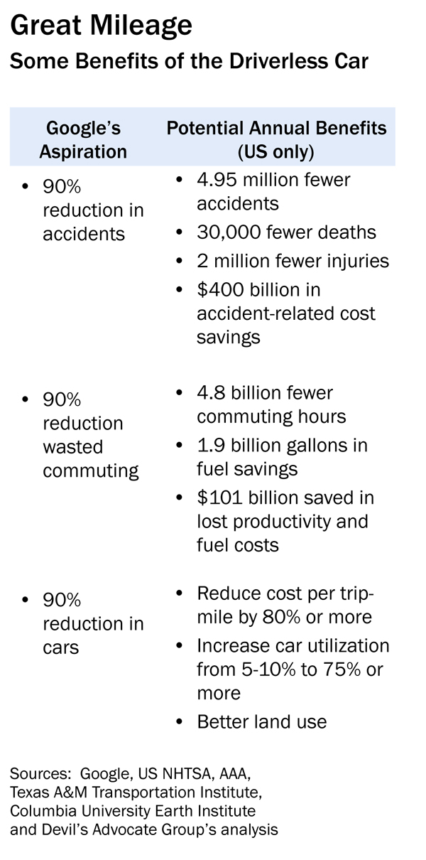

Slide 12
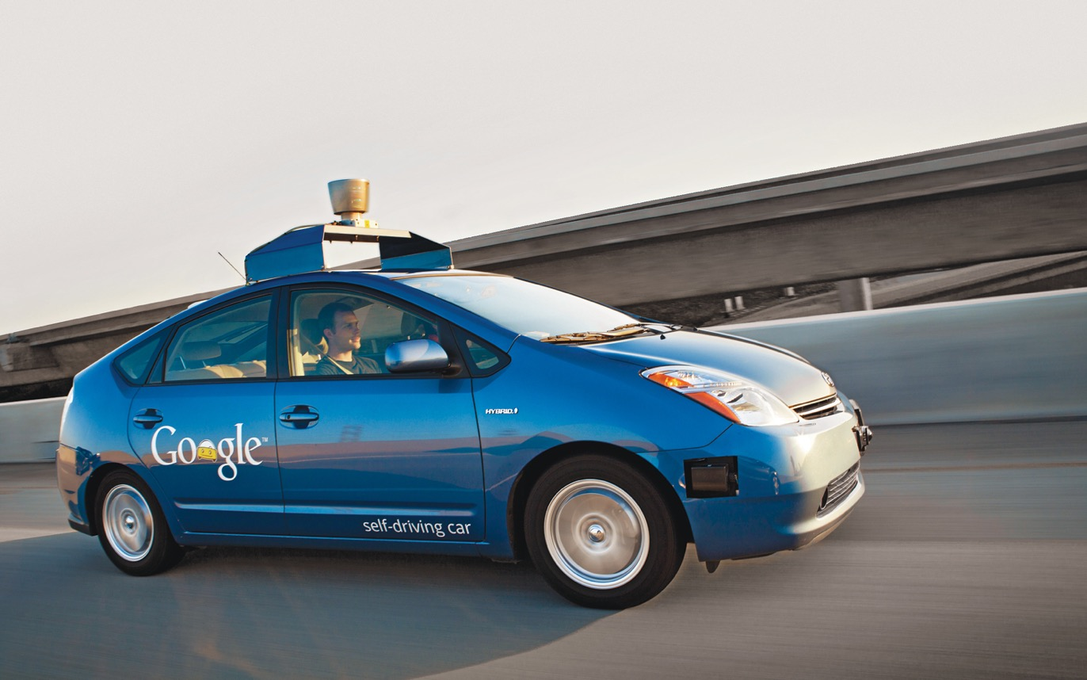

Slide 13
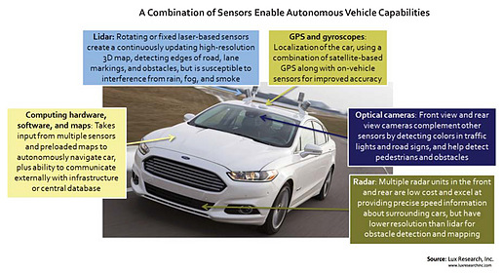

Slide 14
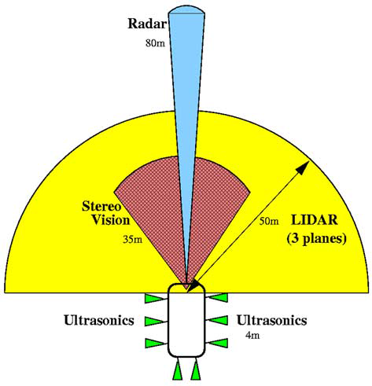
Sensing system components and effective ranges.
Notes:
Oxju”ner et al.: Systems for Safety and Autonomous Behavior in Cars: The DARPA Grand Challenge Experience

Slide 15
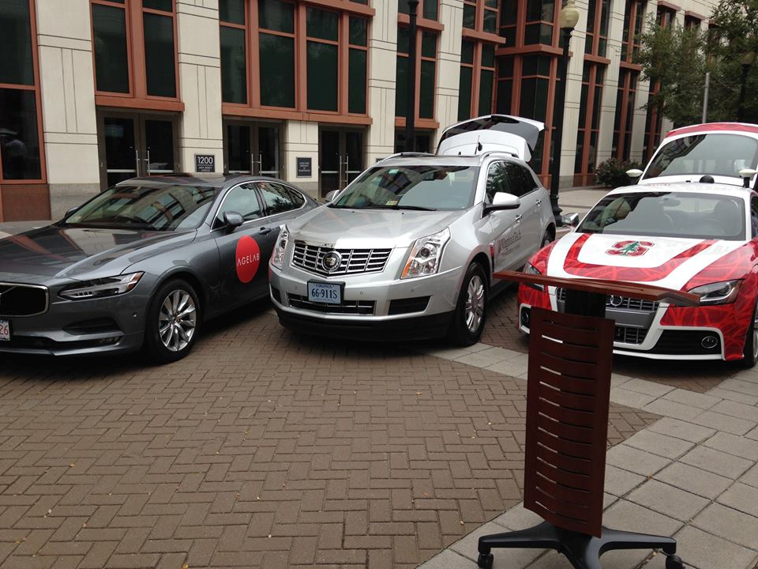

Notes:
https://www.facebook.com/VirginiaTechTransportationInstitute/photos/a.292391267465555.62808.204223336282349/1094972490540758/?type=3&theater

Slide 16

Notes:
https://amyxinternetofthings.com/wp-content/uploads/2017/05/Autonomous-Car-1.jpg

Slide 17
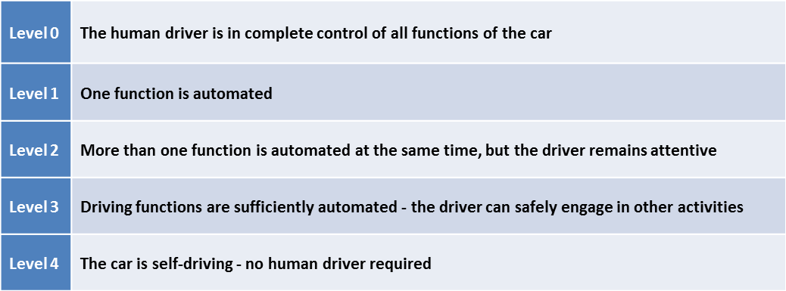
LEVELS OF AUTONOMY
NHTSA

Slide 18
LEVELS OF AUTONOMY
Society of Automotive Engineers
SAE

Slide 19
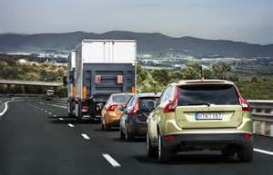
PLATOONING

Slide 20
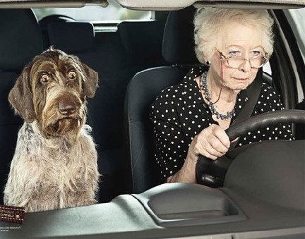

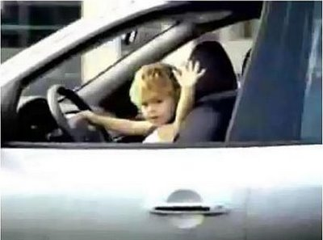

Driver??

Slide 21
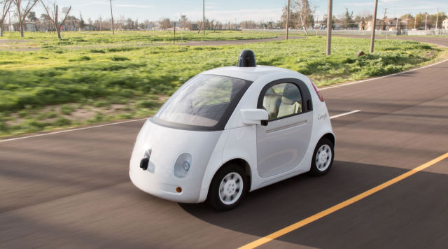
NHTSA rules that AI can be sole driver of Google’s self-driving cars
Highway Administration ruling means steering wheel, pedals not needed.
Sebastian Anthony (UK) - 2/10/2016, 8:46 AM : ARS Technica

Slide 22



Slide 23


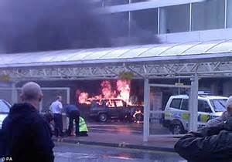

Slide 24
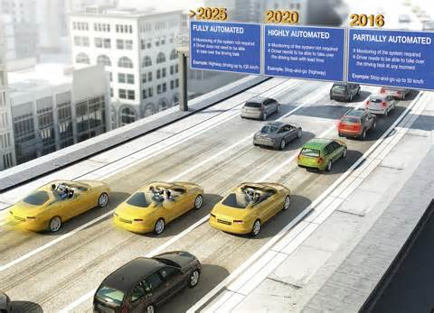

Slide 25

Federal Automated Vehicles Policy
Accelerating the Next Revolution In Roadway Safety
September 2016

Slide 26
This Policy is an important early step in that effort. We are issuing this Policy as agency guidance rather than in a rulemaking in order to speed the delivery of an initial regulatory framework and best practices to guide manufacturers and other entities in the safe design, development, testing, and deployment of HAVs. In the following pages, we divide the task of facilitating the safe introduction and deployment of HAVs into four sections:
Vehicle Performance Guidance for Automated Vehicles
Model State Policy
NHTSA’s Current Regulatory Tools
New Tools and Authorities

Slide 27
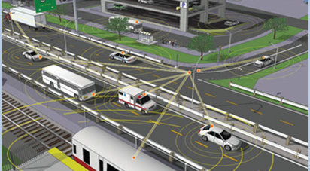
Connected Vehicle Environment
Connected Vehicle Concept (U.S. Department of Transportation)

Slide 28
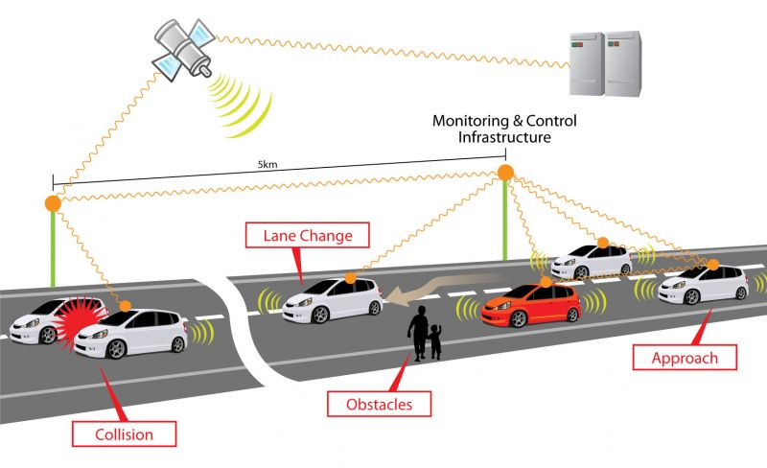

Slide 29
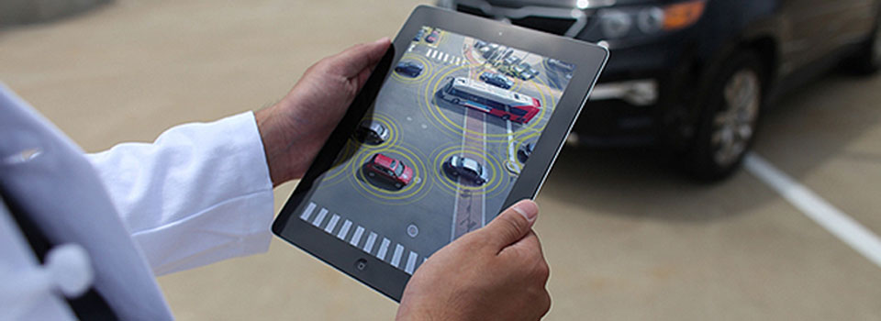
Vehicle to Mobile Devices

Slide 30

Android Auto App

Slide 31
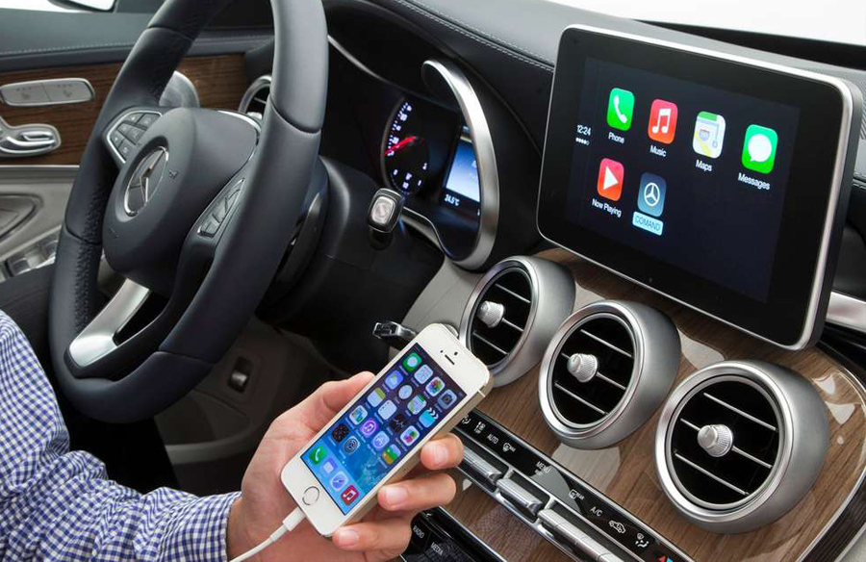
Apple CarPlay App

Slide 32
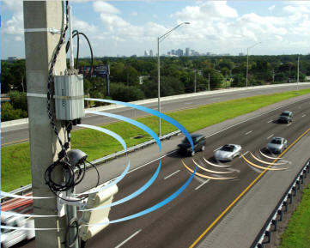
Dedicated Short Range Communications (DSRC)
http://www.dailywireless.org/2011/10/14/world-congress-on-talking-cars/

Slide 33
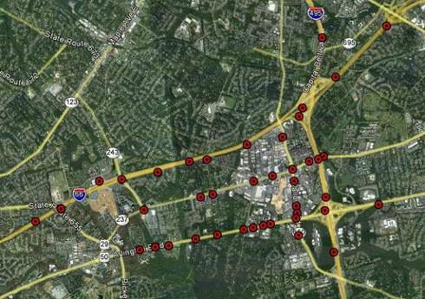



Interstate 66 VDOT Connected Road Test Bed: Fairfax County

Slide 34
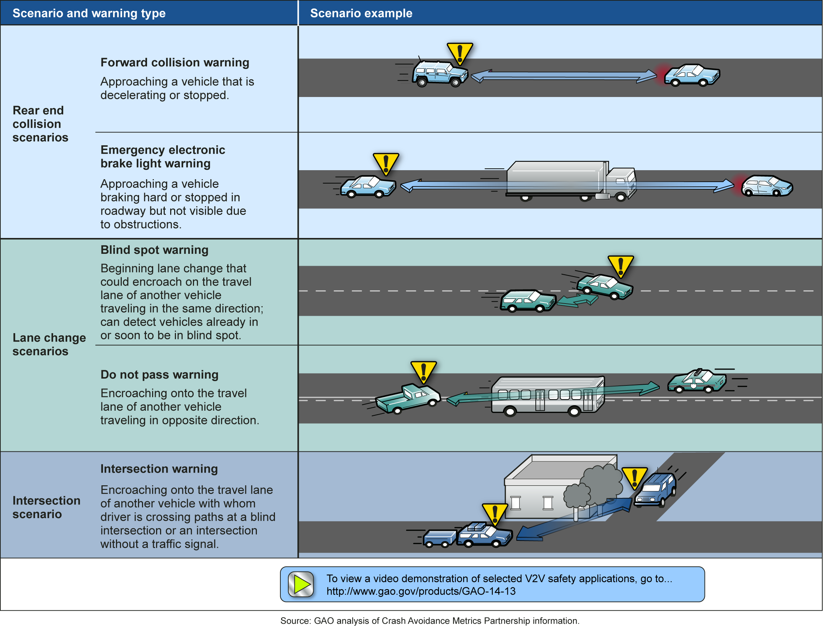

Slide 35
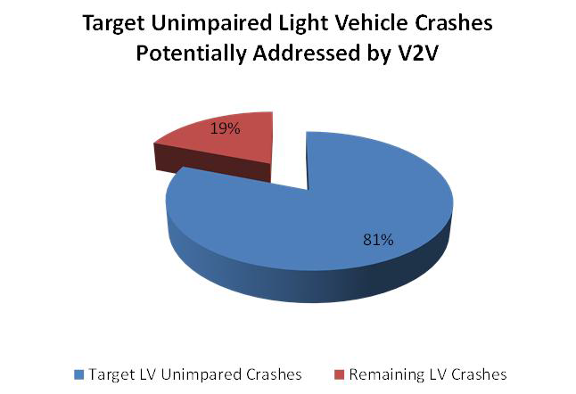
Vehicle-to-Vehicle Communications: Readiness of V2V Technology for Application

Slide 36
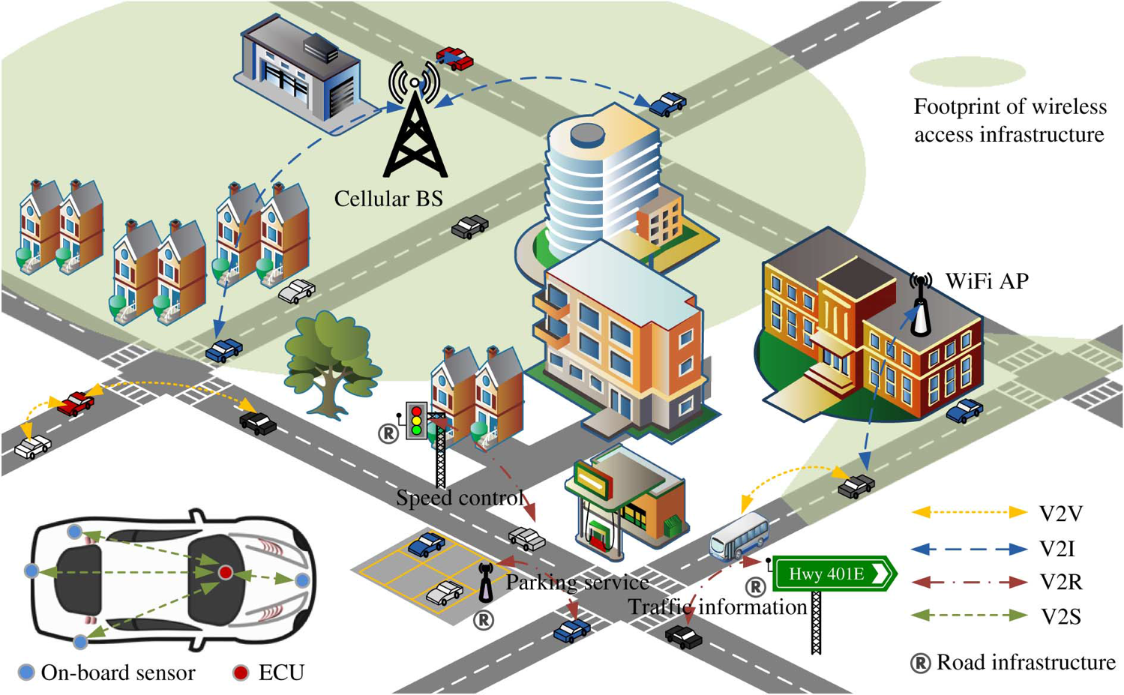
IEEE INTERNET OF THINGS JOURNAL, VOL. 1, NO. 4, AUGUST 2014

Slide 37
Basic Safety Message
Transmitted every tenth of a second and contains:
GPS Position
Speed
Acceleration
Heading
Vehicle Control Information
Transmission State
Brake Status
Steering Wheel Angle
Path History
Path Prediction
Vehicle Information is autonomous and No PII included
Security System

Slide 38
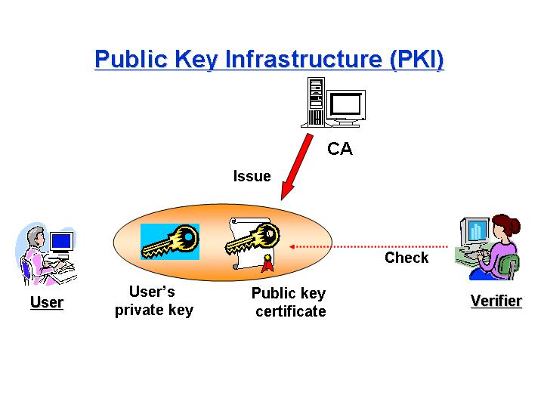

Slide 39
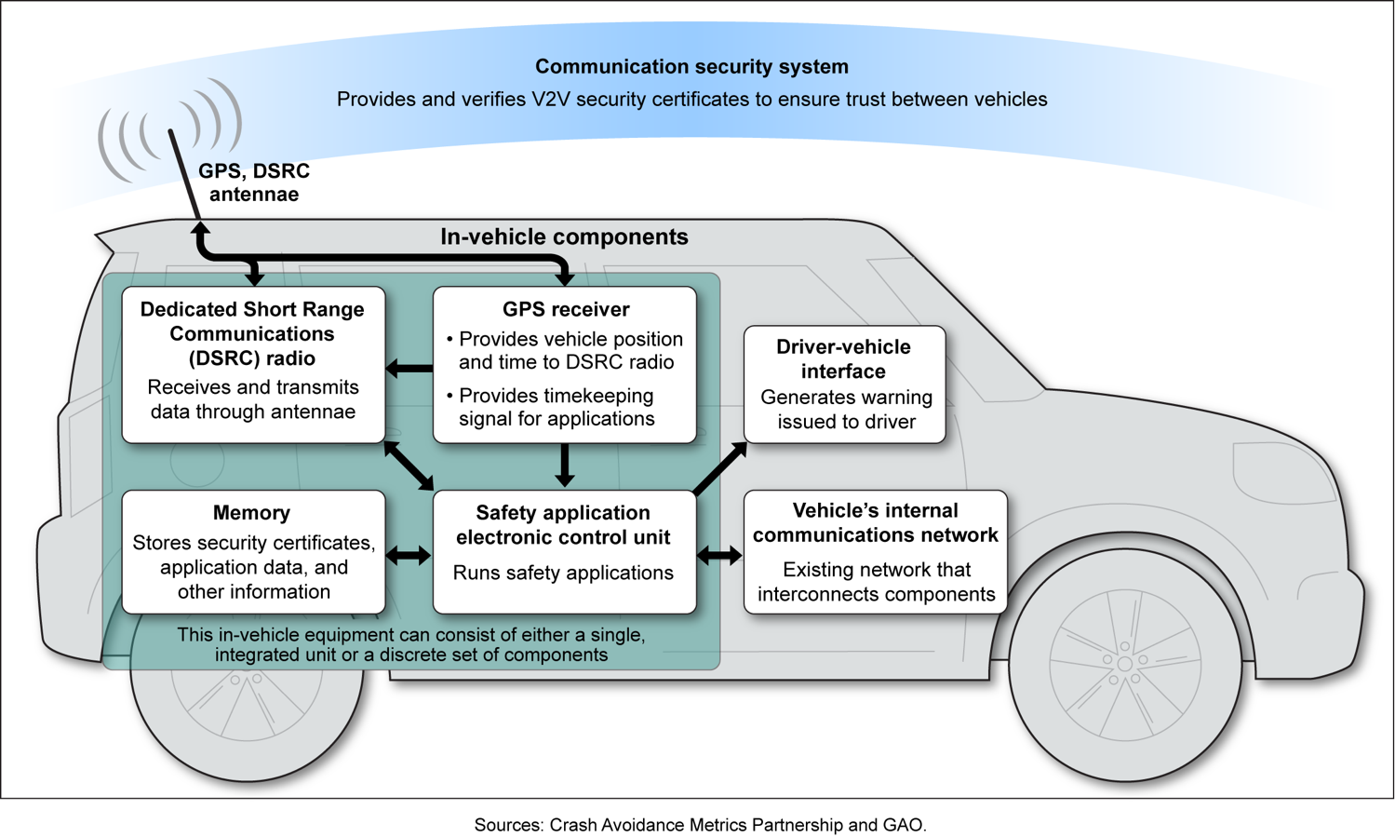

Slide 40

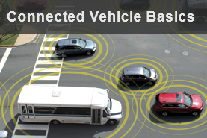
Research Areas
Accelerating Deployment
Automation
Connected Vehicles
Emerging Capabilities
Enterprise Data
Interoperability

Slide 41
Liability / Insurance
What happens when Technology fails???

Slide 42

Tesla Model S
Fatal Crash
May 7, 2016

Slide 43
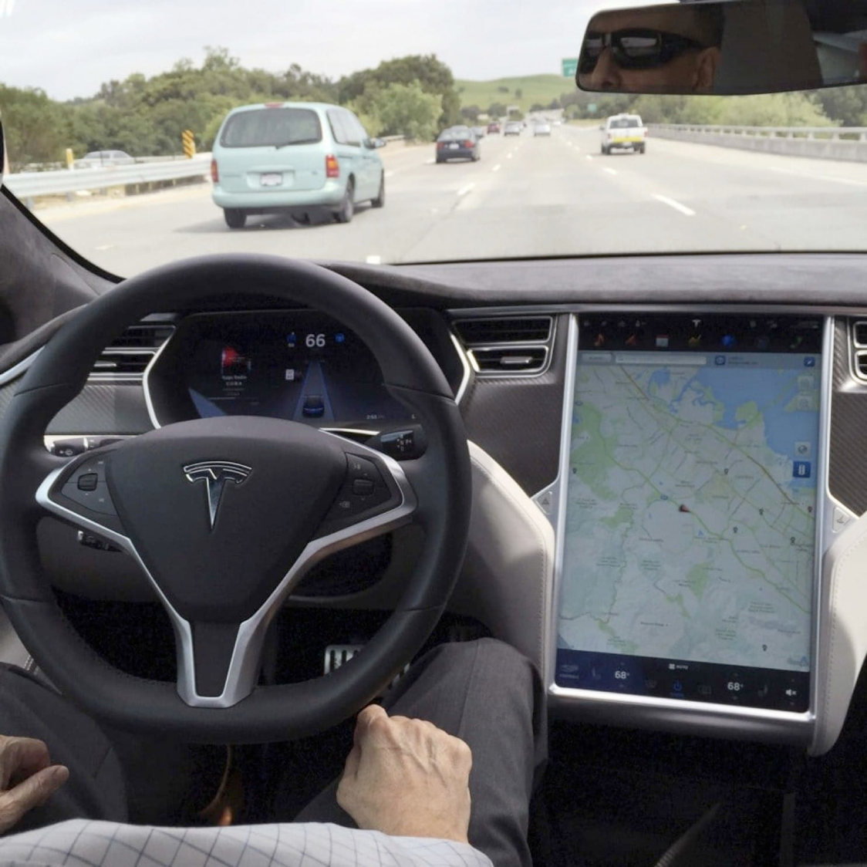

Slide 44
FFH
Notes:
Excerpt: Florida Highway Patrol crash report taken from NTSB Report: https://dms.ntsb.gov/public/59500-59999/59989/604697.pdf

Slide 45
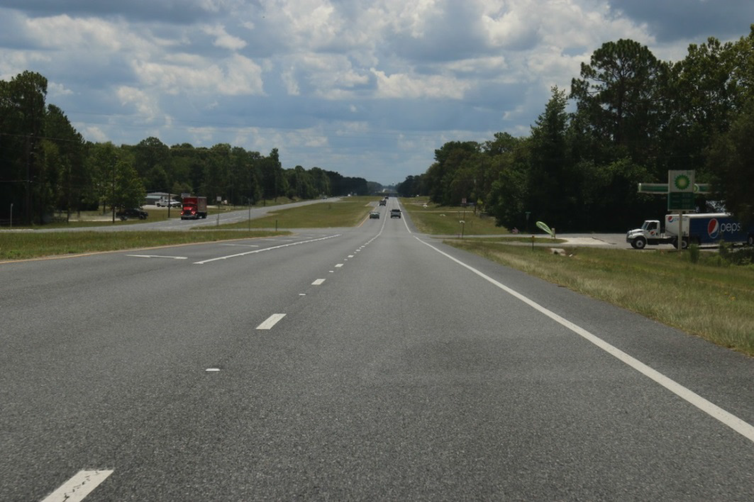
Notes:
https://dms.ntsb.gov/public/59500-59999/59989/604690.pdf

Slide 46
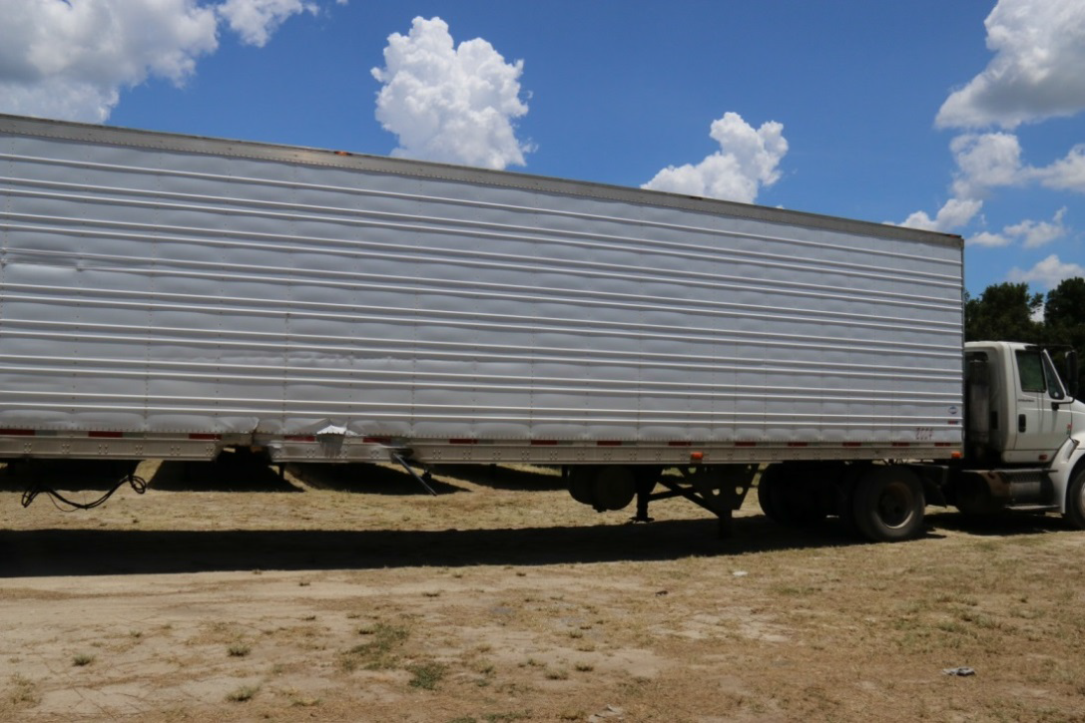

Slide 47
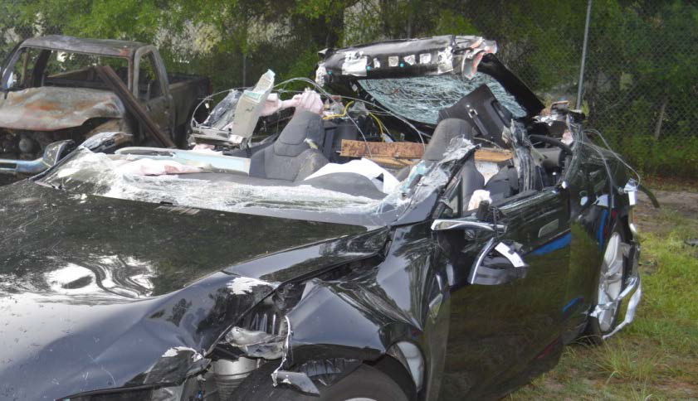

Slide 48
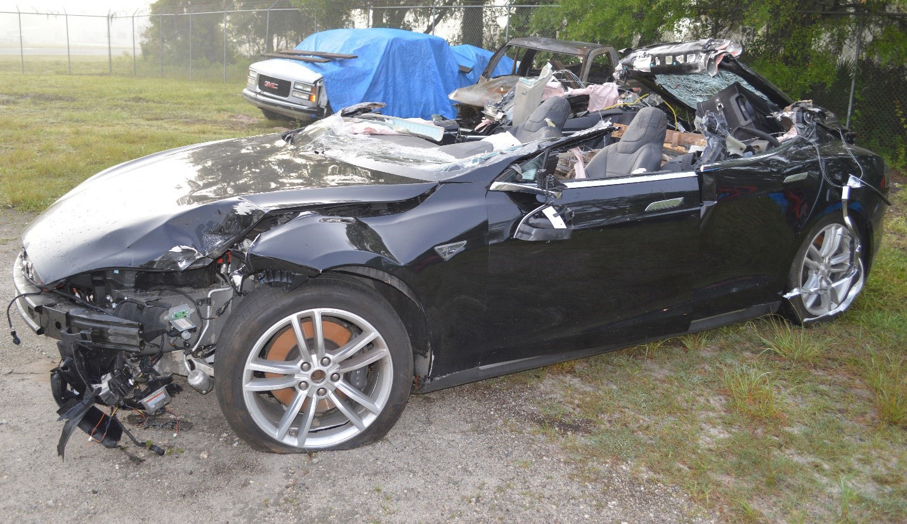
Photo: Florida Highway Patrol

Slide 49
On June 28, 2016, NHTSA opened PE16-007 to
“examine the design and performance of any automated driving systems in use at the time of the crash.
NHTSA’s examination did not identify any defects in the design or performance of the AEB or Autopilot systems of
the subject vehicles nor any incidents in which the systems did not perform as designed.

Slide 50
NTSB Press Release
National Transportation Safety Board Office of Public Affairs
Driver Errors, Overreliance on Automation, Lack of Safeguards, Led to Fatal Tesla Crash
9/12/2017
WASHINGTON (Sept. 12, 2017) — The National Transportation Safety Board determined Tuesday that a truck driver’s failure to yield the right of way and a car driver’s inattention due to overreliance on vehicle automation are the probable cause of the fatal May 7, 2016, crash near Williston, Florida.

Slide 51
NTSB Findings September 12, 2017
9. The way that the Tesla Autopilot system monitored and responded to the driver’s interaction with the steering wheel was not an effective method of ensuring driver engagement.
10. Without the manufacturer’s involvement, vehicle performance data associated with highly automated systems on vehicles involved in crashes cannot be independently analyzed or verified.
11. A standardized set of retrievable data is needed to enable independent assessment of automated vehicle safety and to foster automation system improvements.

Slide 52

Tesla Introduces ‘Substantial Improvements’ to Autopilot
By Dana Hull | September 12, 2016
Radar images vs. optical camera images
Positive control when Driver ignores warnings
Notes:
file:///C:/Users/jerry.davis/Desktop/Distracted%20Driving%20Summit/Tesla%20Introduces%20'Substantial%20Improvements'%20to%20Autopilot.htm

Slide 53




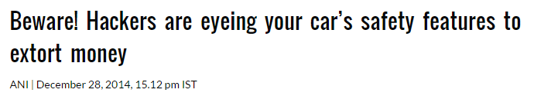

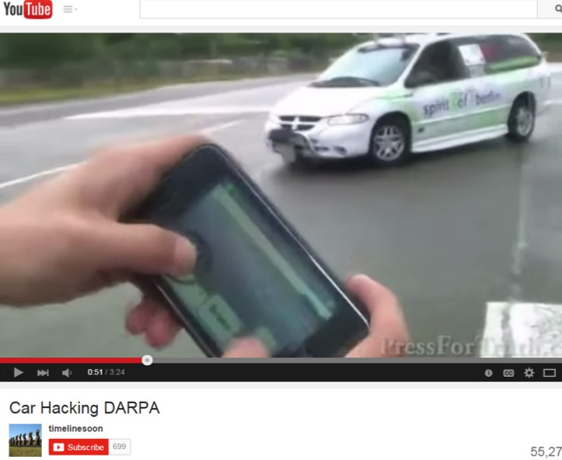




It’s All Over The News…….

Slide 55
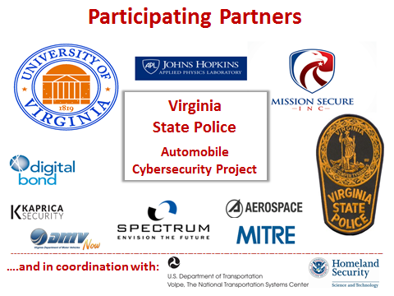

Slide 56
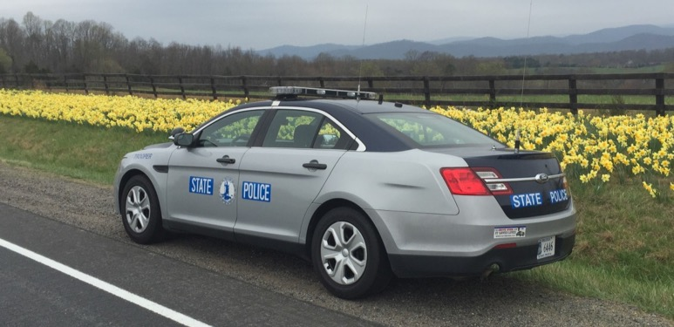
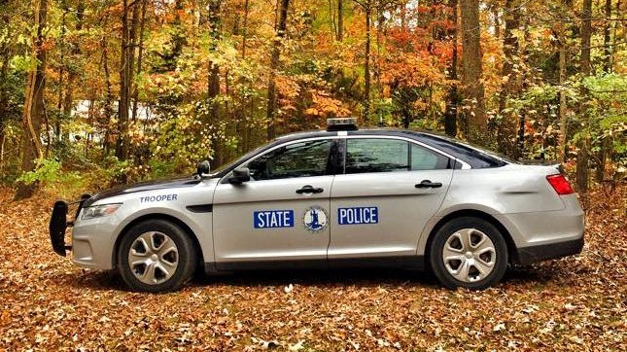

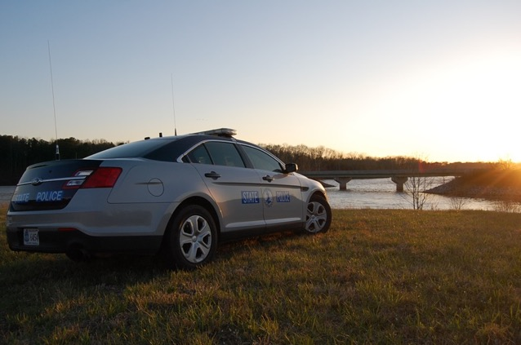
Notes:
But the need is very real because patrol cars - “blue-and-grays” as we call them in the Virginia State Police - is every trooper’s office.
A state trooper spends practically his and her entire shift in the vehicle for the purpose of
routine patrol,
responding to an emergency call,
researching information,
communicating with dispatch and other law enforcement personnel,
criminal transport,
dignitary transport,
pursuits,
traffic escorts, and so on.
We have multiple security layers for someone to gain access to one of our headquarters and Area offices…just like we do for our computer systems. But, just how effective and truly aware are we as public safety professionals of the vulnerabilities of our patrol vehicles to a cyber attack? And that’s what Barry and I have set out to understand and address.

Slide 57
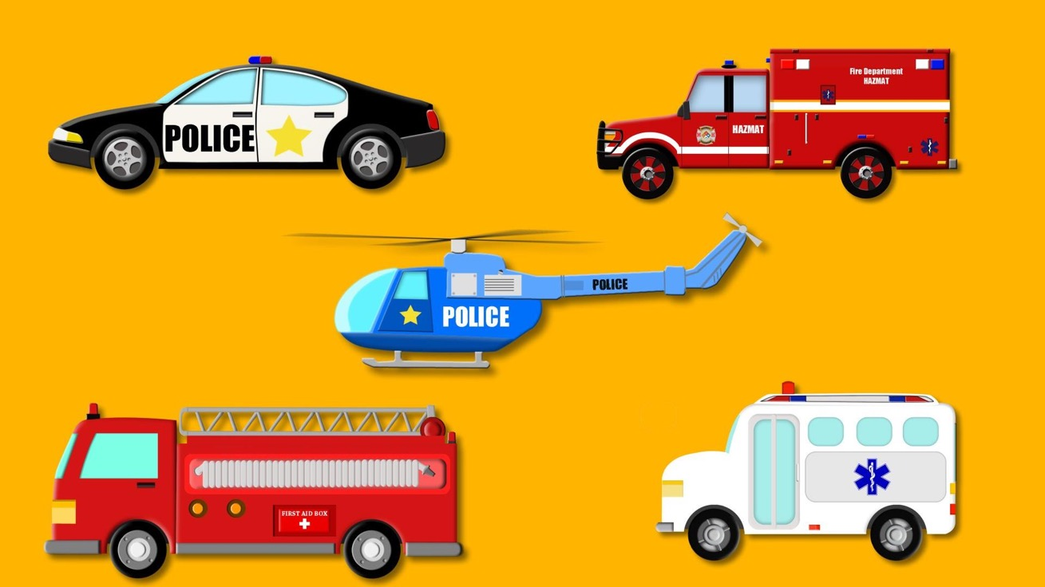
Notes:
This project has created a more universal discussion about this issue and the potential risks that could exist for law enforcement, fire and EMS vehicles. Fortunately…to date…there have been no reported incidents of a first responder’s vehicle falling victim to a cyber attack.
In Paris, we saw firsthand what a terrorist can do by physically driving a commercial truck into a crowded festival. Just think of the devastating potential of a multi-ton ladder truck or police helicopter being overtaken by a cyber-terrorist entity and purposely used as a target of destruction…and the terrifying, mass-casualty consequences.

Slide 58

Notes:
Not to worry, Hollywood has already played out that worst-case scenario in the latest installment of the “Fast & the Furious” series…called “Fate of the Furious” movie. Not going to show it because I think it’s over the top, but it’s not hard to imagine how a nefarious actor could make use of cyber attacks to reek havoc in our communities and with our agencies.

Slide 59

Notes:
But, those of us in law enforcement, fire and emergency response have a duty to be preventive in nature. No matter what state, county, city or town you reside in…your local, regional, state and federal law enforcement personnel have taken an oath to serve and protect you from the criminal element. But we have to make sure we protect ourselves, too…or else our response to fulfill our duties can be jeopardized in the course of our actions. So, the threat-potential for public safety vehicles is out there. And, our responsibility to address the issue is now. To consider it, to address potentialities so the mission is not impacted.

Slide 60
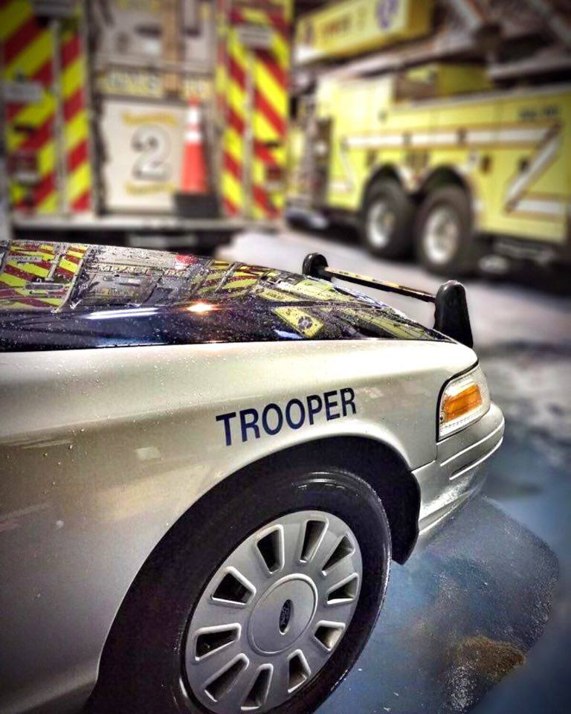
“What” do we need to do as public safety professionals to reduce the risks of a cyber attack?
“What” training protocols do we need in place to make certain our personnel can identify a cyber attack if/when it occurs?
“What” practices do we need to add to our personnel’s existing safety vehicle checks?
Notes:
So, our purpose today is not so much the “how” as it is the preventative “what”…
“What” do we need to do as public safety professionals to reduce the risks of a cyber attack?
“What” training protocols do we need in place to make certain our personnel can identify a cyber attack if/when it occurs?
“What” practices do we need to add to our personnel’s existing safety vehicle checks?
I know the data is critically important to Barry and his research…the open dialogue and putting ideas into practice are what’s essential for the public safety community.

Slide 61
Assess the possibility of cyber-attack.
Ensure the security of police vehicle fleets.
Develop a forensic capability to examine and analyze a vehicle at the scene of an incident.
Virginia State Police
Cybersecurity Requirements
Notes:
Assess – General Awareness that this activity could occur and be the causative factor in an incident.
Ensure – The mission is not impacted so that public safety services can be provided without interruption or mission degradation.
Develop – A forensic capacity, because at the end of the day we are responsible for an investigation, and a crime has been committed.

Slide 62

Project Phases – 90 Days
Phase I – Assessment / Study
Phase II – Attacks
Phase III – Solutions / Forensics
Phase IV - Documentation
Notes:
Phase I – Apply cyber assessment to critical functions of Chevrolet and Ford cruisers predominantly used in our agency. Estimate the ease of creating an attack and associated costs to perform it.
Phase II – Develop cyber attacks on cars based on use cases supplied by VSP and formulate defense strategies
Phase III – Create active countermeasures
Phase IV – Document the work and create a scorecard for use by management to make decisions regarding cyber related issues.

Slide 63
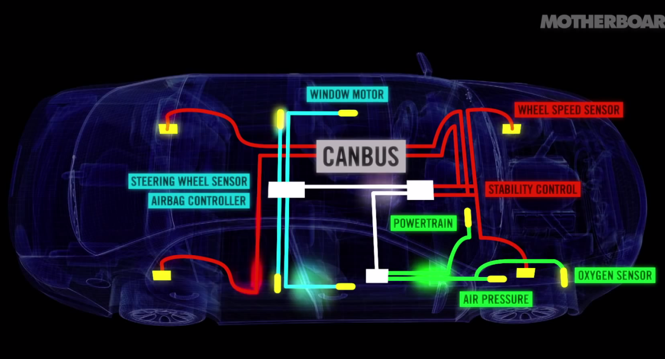
Cars Now Contain Lots of Cyber Attack Access Paths

Slide 64
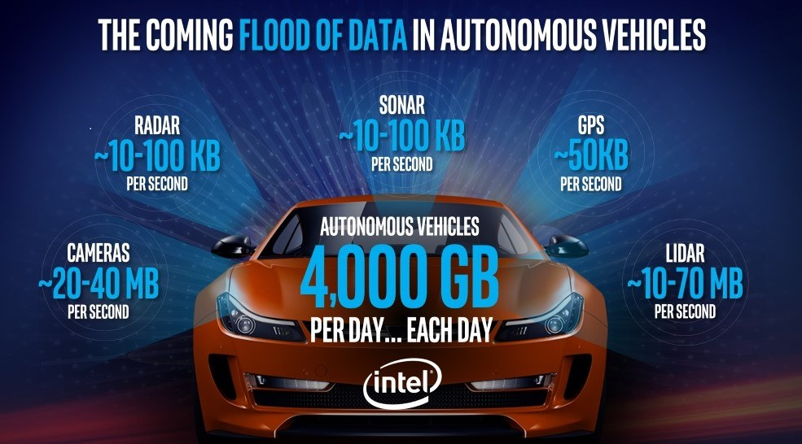
Notes:
https://www.intel.com/content/www/us/en/automotive/autonomous-vehicles.html?cid=sem43700024793798558&intel_term=%2Bautonomous+%2Bvehicles&gclid=EAIaIQobChMIivTAg-eT1gIVTEsNCh3npgltEAAYASAAEgIP0_D_BwE&gclsrc=aw.ds

Slide 65
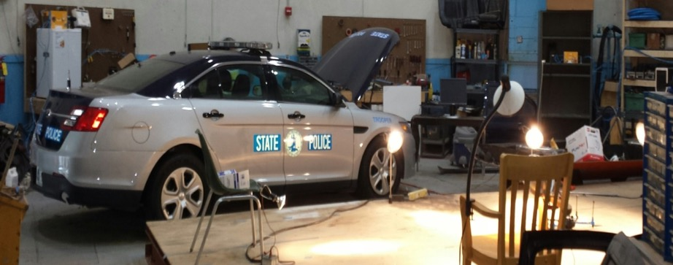
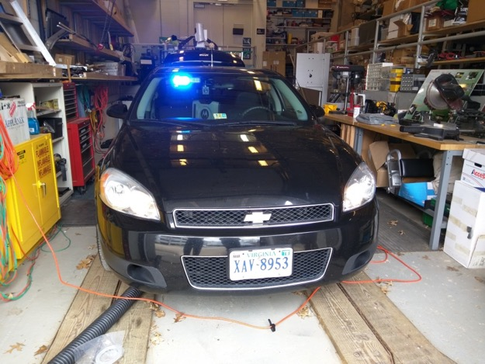
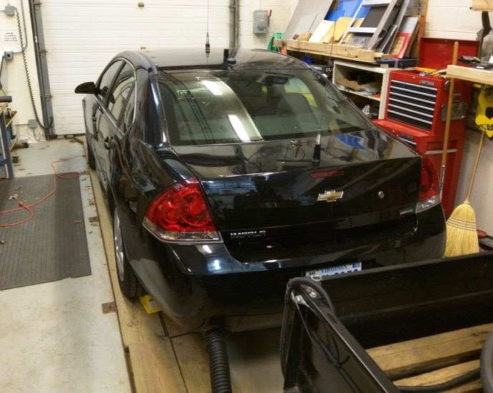
Notes:
Here are the vehicles used in the project. A 2012 Chevrolet and 2013 Ford.

Slide 66
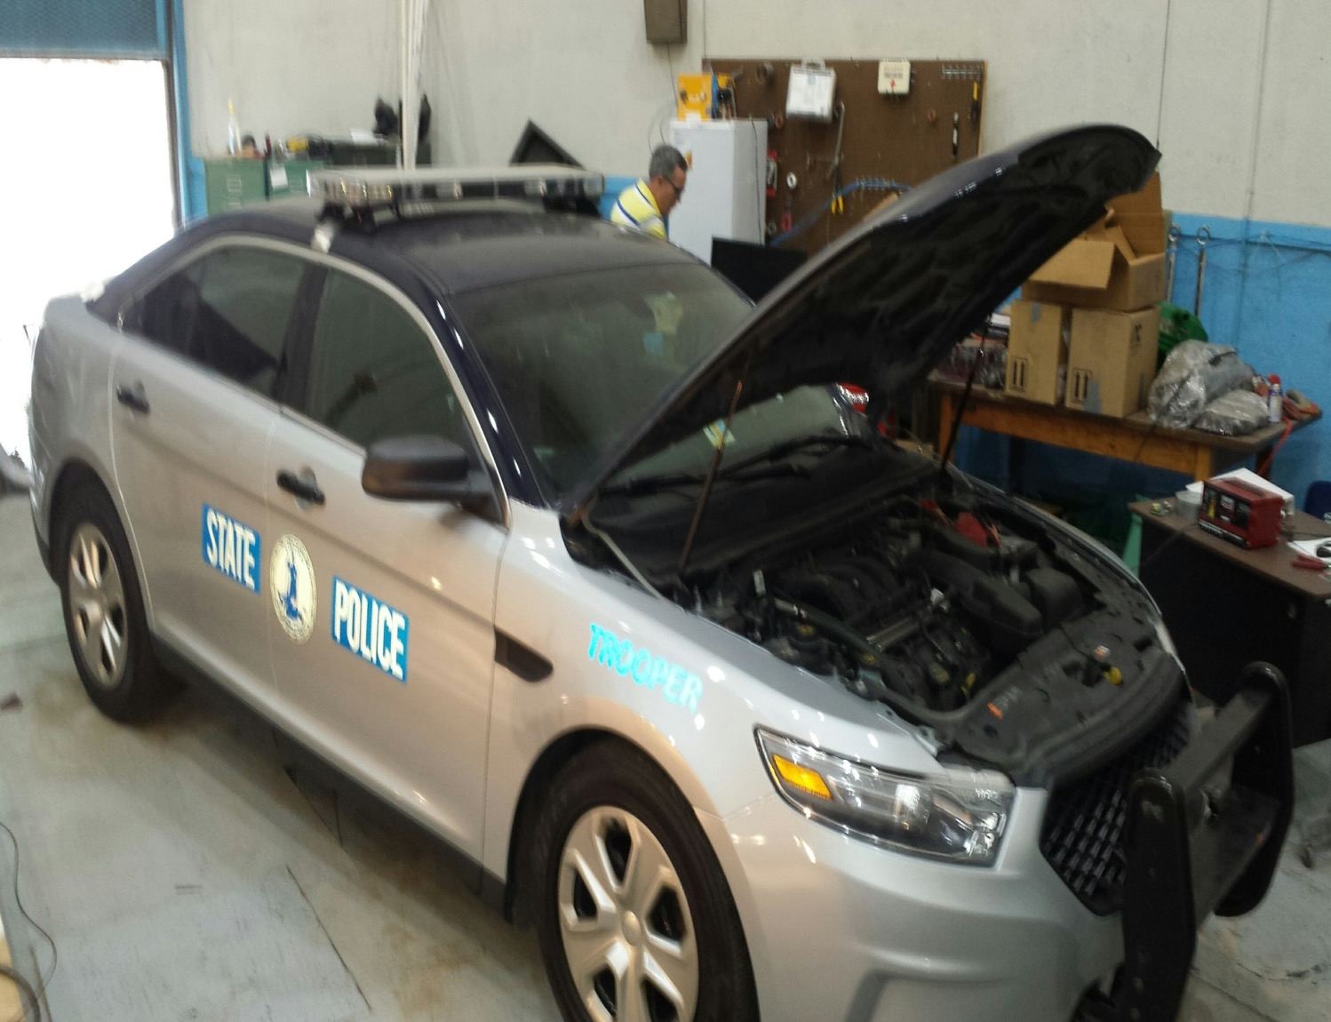

Slide 67
VEHICLE ATTACK | ACTION | CONSEQUENCE
Uncontrolled acceleration to limit | Loss of control | Potential for accident/injury/death to Trooper or civilians
Disengagement of brakes | Loss of control | Potential for accident/injury/death to Trooper or civilians
Asymmetrical braking | Loss of control | Potential for accident/injury/death to Trooper or civilians
Deployment of airbag at speed | Loss of control | Potential for accident/injury/death to Trooper or civilians
Cancellation of all lighting (external & internal) at night | Loss of control | Potential for accident/injury/death to Trooper or civilians
Transmission operation altered | Trooper Stops vehicle | Vehicle removed from service, inability to answer calls
Alter RPM,Throttle, Timing settings | Trooper Stops vehicle | Inability to answer calls for service, vehicle submitted for maintenance
Disengage Electronic Stability Control | Trooper Stops vehicle | Inability to answer calls for service, vehicle submitted for maintenance
Disengage ABS system | Warning Light illuminated | No action required immediately, submitted for service
Shutoff engine no restart | Vehicle stops | Vehicle towed for service, inability to answer calls
Prevent engine from turning off or starting | None | Vehicle removed from service, inability to answer calls
Notes:
After assessment then the attacks were developed from this listing provided by me. Notice the first 5 result in loss of control and could result in injury/ death.

Slide 68
VEHICLE ATTACK | ACTION | CONSEQUENCE
Instrument panel: Falsify readings | Trooper Stops vehicle | No traffic enforcement activity, removed from service
Door Locks activated continuously | None | Inability to answer calls for service, vehicle submitted for maintenance
Unlock Doors | Attempt to secure vehicle | Theft of firearms, radio, and other equipment
Unlock Trunk | Attempt to secure vehicle | Theft of firearms, radio, and other equipment
Lower windows | Attempt to secure vehicle | Theft of property, possible damage from elements
Horn Blows continuously | Remove vehicle from service | Inability to answer calls for service, vehicle submitted for maintenance
Heat / Air conditioning activated continuously | Remove vehicle from service | Inability to answer calls for service, vehicle submitted for maintenance
Car Radio On with increase volume | Remove vehicle from service | Inability to answer calls for service, vehicle submitted for maintenance
Wiper / Washer activated continuously | Remove vehicle from service | Inability to answer calls for service, vehicle submitted for maintenance
Wiping Code | None | No Forensic Investigation capability

Slide 70
Recommendations
Public Safety personnel should currently receive annual training on cyber awareness.
Cyber awareness should now include physical systems – police cars, bomb robots, UAV’s, GPS, LPR’s, radio systems, body cams, etc….

Slide 71
Recommendations cont.
Agency Managers should review / formulate policy for physical inspections of external and internal areas of police vehicles (prior to duty, return from maintenance from 3rd party vendors)
Inspect OBD-II port beneath dash, any device attached should be treated as suspicious. Vehicle removed from service until cleared.
Notes:
Already reported that gang members employed to wash an agencies department vehicles used the opportunity to gain useful information from inside the vehicle

Slide 72
Recommendations cont.
IACP currently in preliminary stages of developing a checklist for use by officers as a general guideline for cybersecurity best practices for physical systems.
Development of lesson plans and training of personnel during initial and Inservice training to generate cyber awareness.

Slide 73
Recommendations cont.
The “Cyber Crime Checklist for Police Chiefs” by IACP used as baseline reference tool. Obtained through the IACP Cyber Center.
All agencies should ensure cybersecurity matters are reflected in their public safety mission requirements, and appropriate personnel are designated to maintain SME in the area.

Slide 74
Recommendations cont.
The Society of Automotive Engineers (SAE) has published Standard J3061;
“Cybersecurity Guidebook for
Cyber-Physical Systems”
This guide addresses cybersecurity threats and identifies minimum standards necessary to secure vehicle systems.

Slide 75
Recommendations cont.
Participate in the DHS Government Vehicle Cybersecurity Steering Committee. Bi-monthly teleconferences to develop actionable information on cyber issues for vehicles operated by governmental entities.
Review existing criminal statutes for applicability to physical systems.

Slide 76
Recommendations cont.
Agencies should partner with the automotive industry, public / private cybersecurity companies, and academia to further research and development.
A critical need is for forensic capability at the scene of an incident for data extraction and analysis.
New policy creation regarding cybersecurity.

Slide 77
Recommendations cont.
Consider reallocation of current patrol assignments to community policing / emergency response roles
How will reduction in revenue impact services?
Technical vs. Tactical skills
Use of technology as a force multiplier

Slide 78
Captain Jerry Davis
Virginia State Police - Wytheville jerry.davis@vsp.virginia.gov
(276) 223-4241

