Slide 1
Distracted Driving
Innovative Education and Enforcement Campaigns

Slide 3
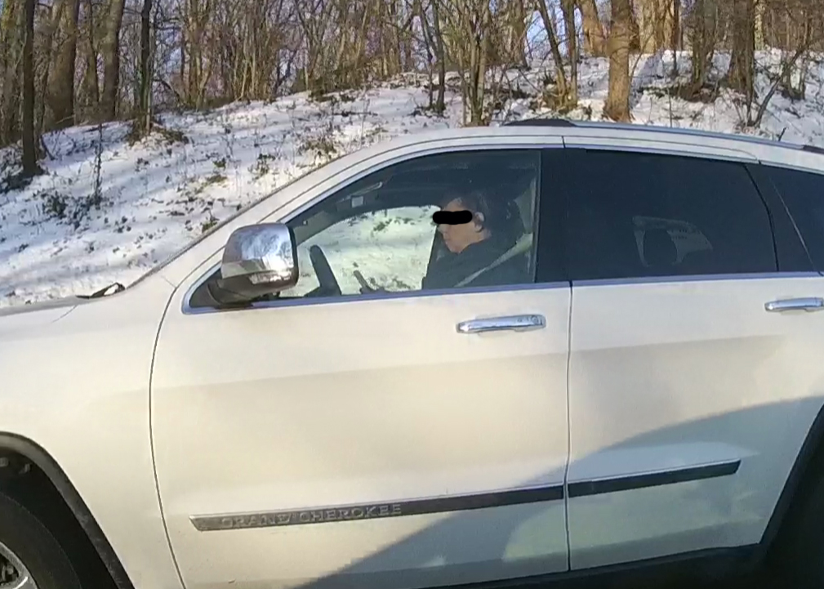

Slide 4
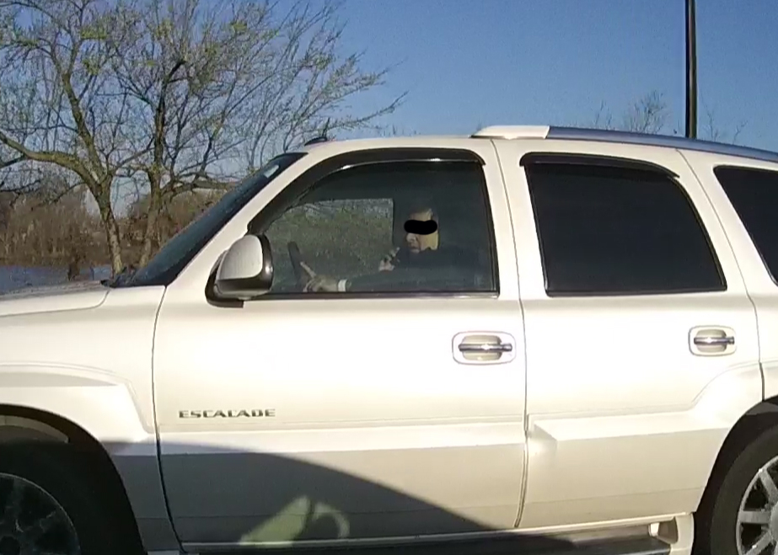

Slide 5
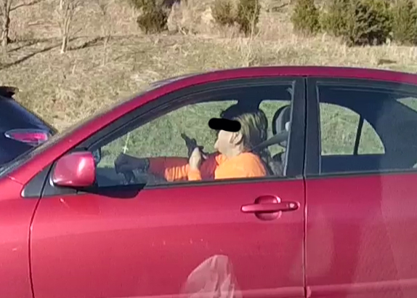

Slide 6
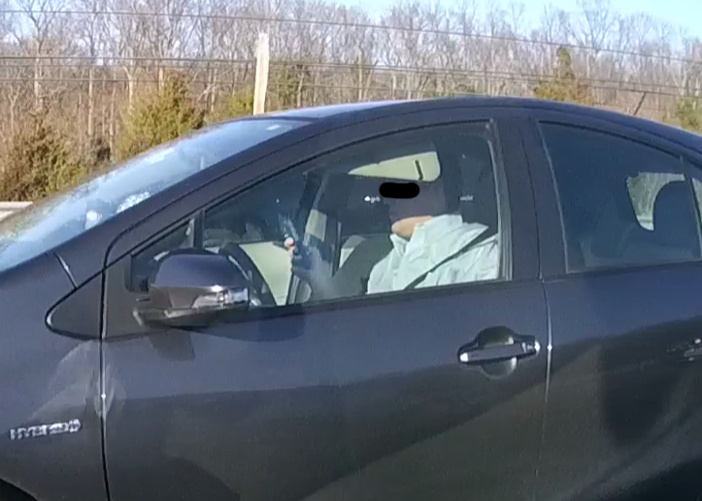

Slide 7
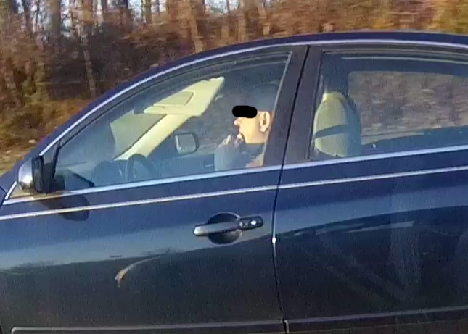

Slide 8
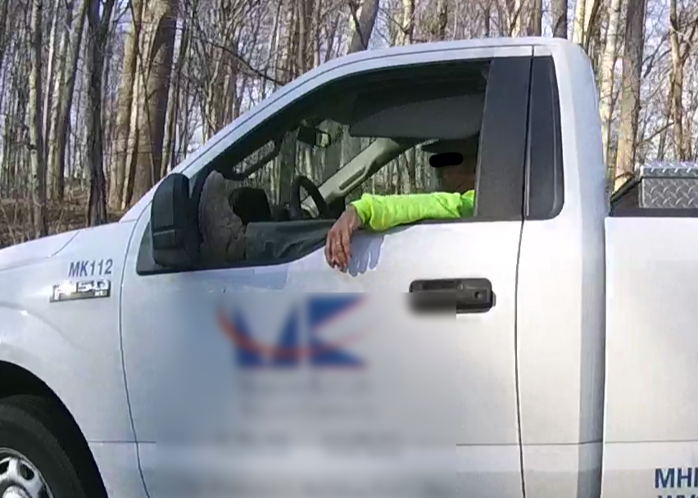

Slide 9
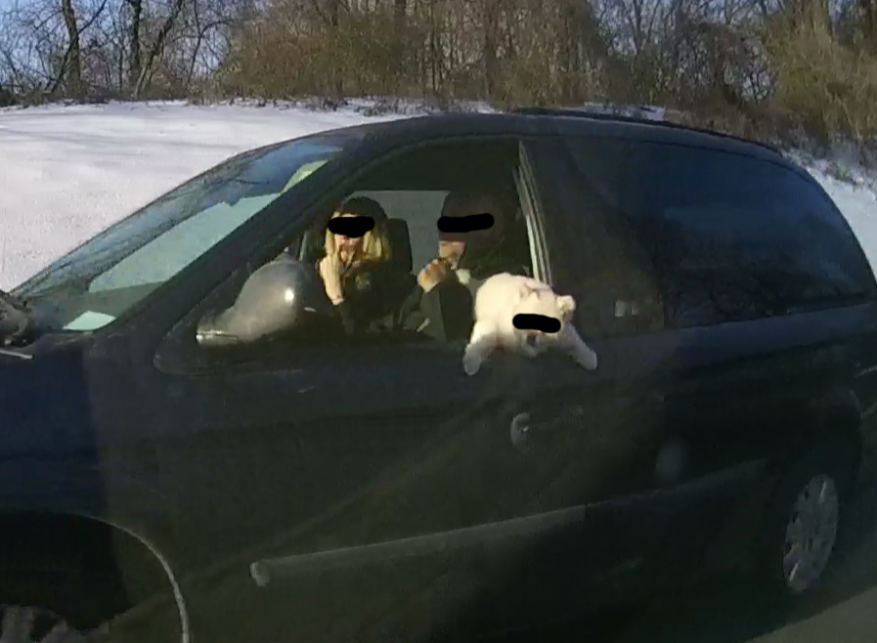

Slide 10
Florida Study

Slide 11
Florida Study

Slide 12
Loudoun County, Virginia

Slide 13
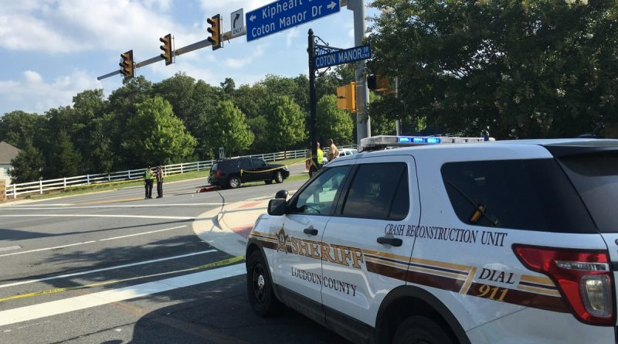
Loudoun County, Virginia

Slide 14
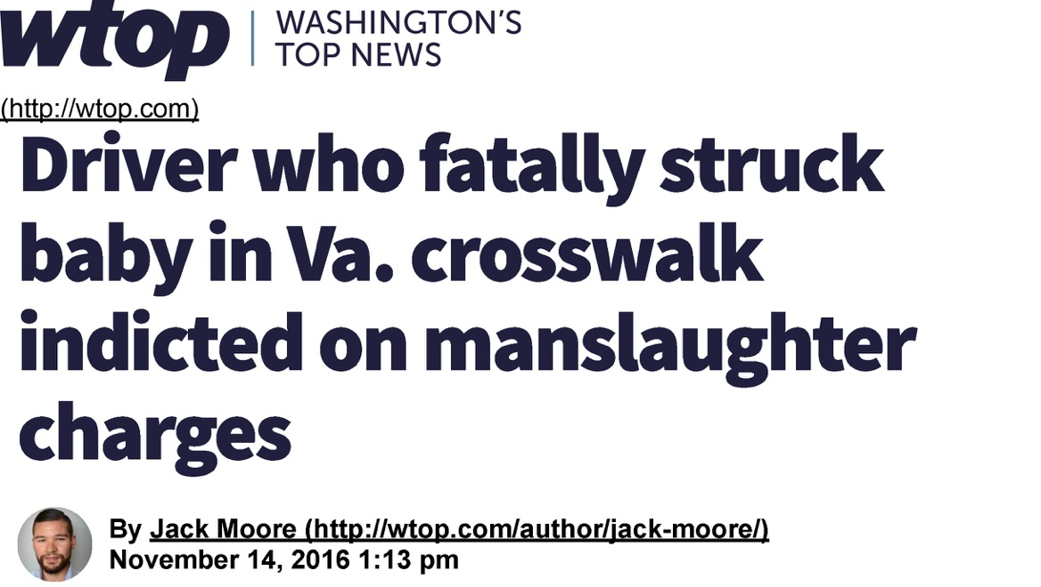
Loudoun County, Virginia

Slide 15
Montgomery County, MD

Slide 17
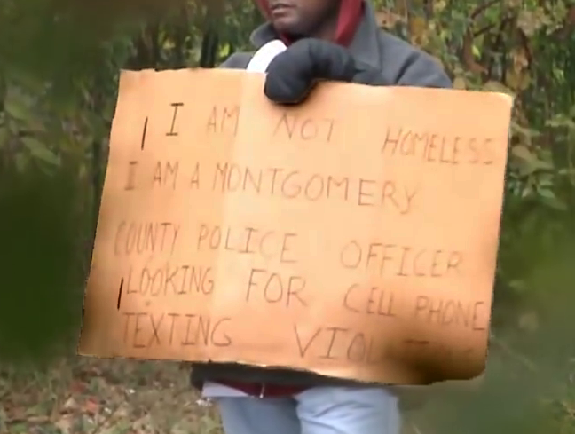

Slide 18
Michigan

Slide 19
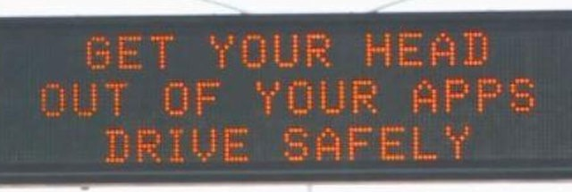
Michigan

Slide 21
California Highway Patrol
Target ages 16-19, 20+
Strategic plan: statewide surveys/enforcement
Agency wide training
Education:
“Impact Teen Drivers”
“Smart Start”
Adult safety presentations
Highway messaging
Social media

Slide 22
Fergus@theiacp.org
Mike Fergus
Program Manager

